Slide 1
Lecture 1
Introduction to numerical integration

Slide 2
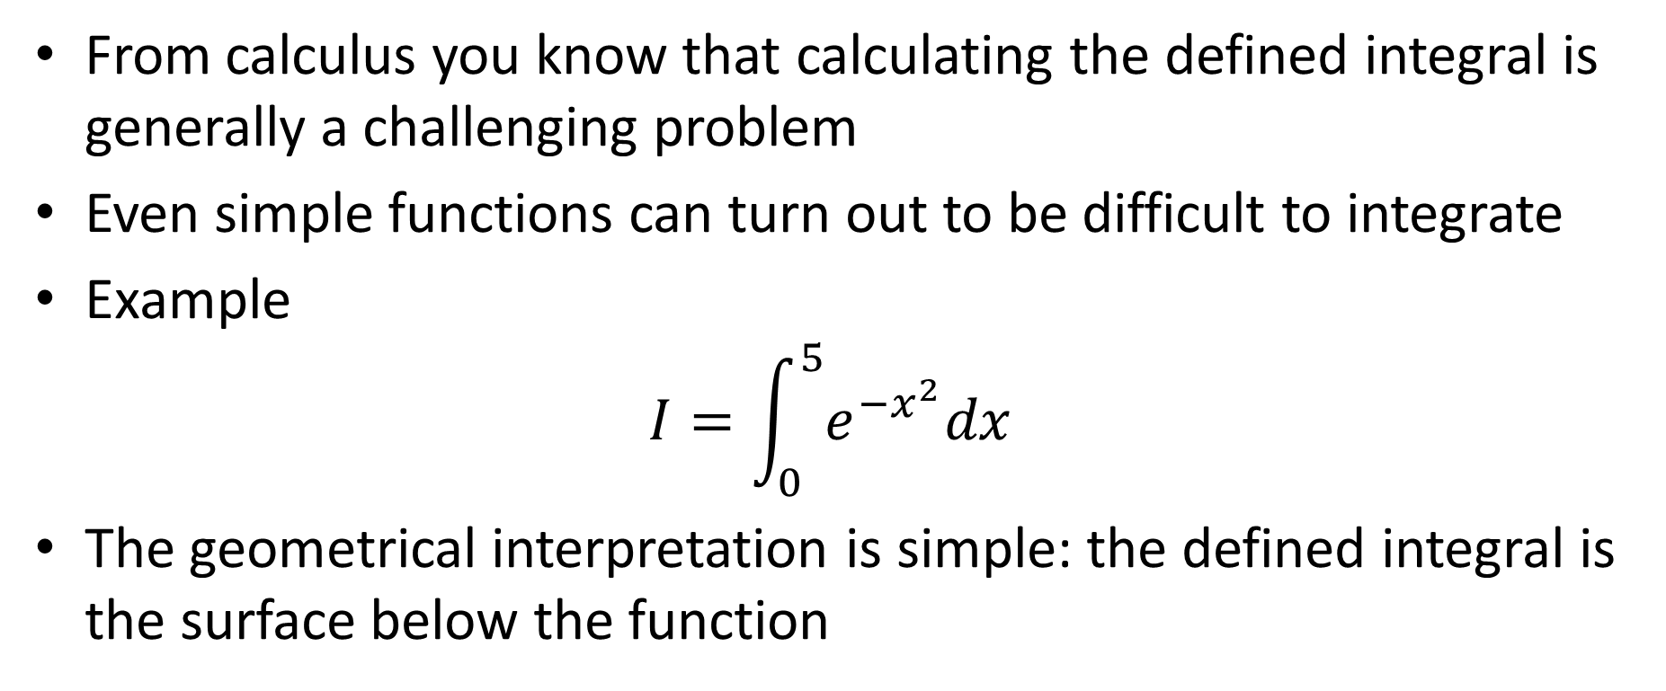
Introduction
From calculus you know that calculating the defined integral is generally a challenging problem
Even simple functions can turn out to be difficult to integrate
Example
$$I=\int_{0}^{5}{e^{−x^{2}}dx}$$
The geometrical interpretation is simple: the defined integral is the surface below the function
Notes:
In this lesson we will learn how we can approximate numerically a defined integral
From calculus you know that calculating the defined integral is generally a challenging problem
In fact even simple functions can turn out to be difficult to integrate
For example $\int_{0}^{5}{e^{−x^{2}}dx}$ cannot be evaluated analytically
If evaluating defined integrals by exact expressions is very challenging, it’s geometrical interpretation is simple: the defined integral is the surface below the function
This interpretation will be very useful to understand intuitively the algorithms we will develop

Slide 3
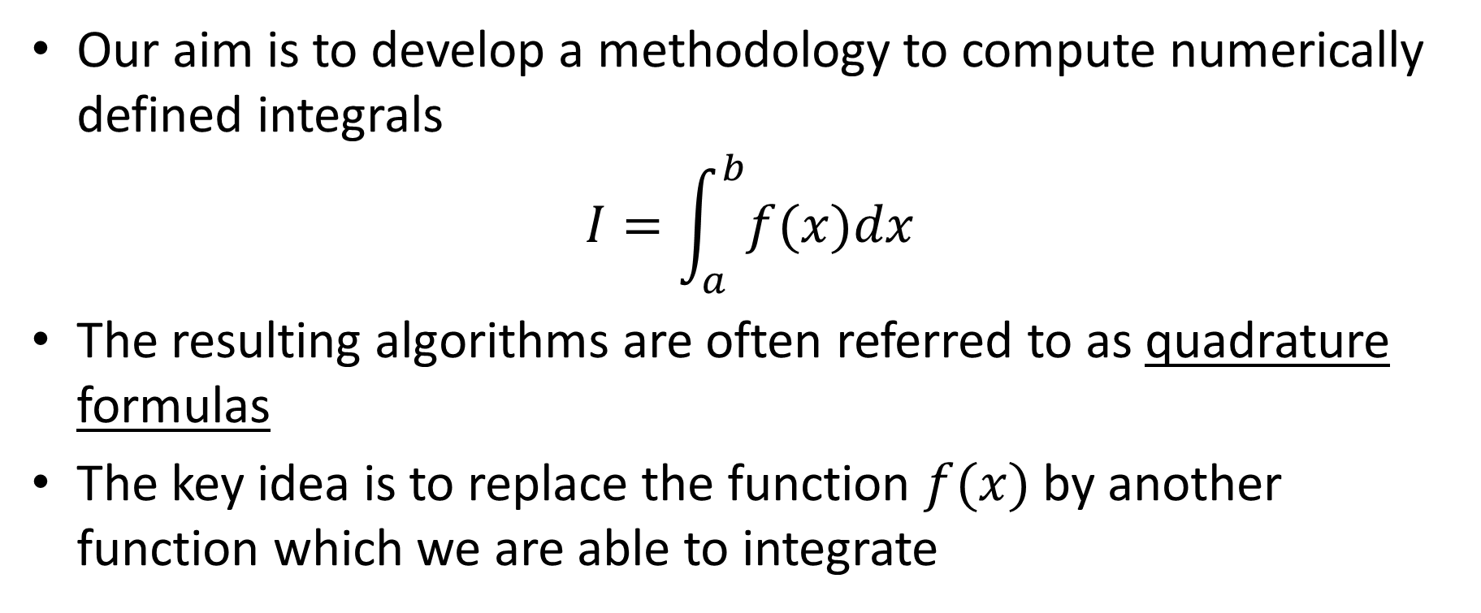
Numerical integration
Our aim is to develop a methodology to compute numerically defined integrals
$$I=\int_{a}^{b}{f(x)dx}$$
The resulting algorithms are often referred to as quadrature formulas
The key idea is to replace the function $f(x)$ by another function which we are able to integrate
Notes:
Our aim is to develop a methodology to compute numerically defined integrals
The resulting algorithms are often referred to as quadrature formulas
The key idea is to replace the function $f(x)$ by another function which we are able to integrate
Which functions are easy to integrate:?
For example polynomial functions
That is exactly what we will do: replace the function f to integrate by a polynomial function approximating f(x).

Slide 4

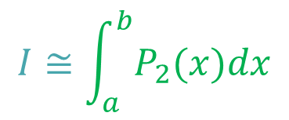



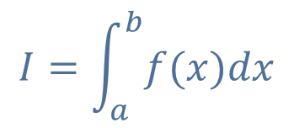





Quadrature Formulas Using Interpolation
$$y=P_{2}(x)$$
$$y$$
$$y=f(x)$$
$$I=\int_{a}^{b}{f(x)dx}$$
$$I≅\int_{a}^{b}{P_{2}(x)dx}$$
$$x$$
$$a$$
$$x_{o}$$
$$x_{1}$$
$$x_{2}$$
$$b$$
Notes:
To find the polynomial approximating the function f(x) we want to integrate we use polynomial interpolation
For this we chose a set of interpolating points over the integration interval [a,b]
For example there points x0, x1 and x2
Based on these three interpolating points we compute a quadratic polynomial P2(x) interpolating f(x)
Integrating P2(x) is simple to do and will give the approximation of the integral we look for.

Slide 5
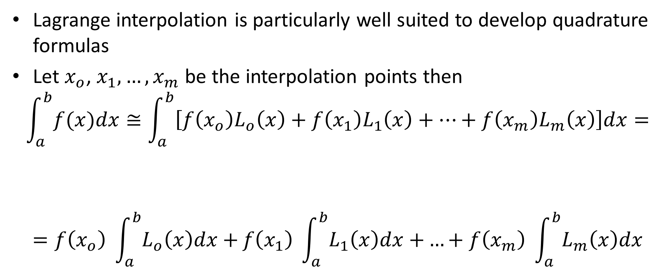
Lagrange interpolation
Lagrange interpolation is particularly well suited to develop quadrature formulas
Let $x_{o}$, $x_{1},…,x_{m}$ be the interpolation points then
$$\int_{a}^{b}{f(x)dx}≅\int_{a}^{b}{\left[f\left(x_{o}\right)L_{o}\left(x\right)+f\left(x_{1}\right)L_{1}\left(x\right)+…+f\left(x_{m}\right)L_{m}\left(x\right)\right]dx=}$$
$$=f\left(x_{o}\right) \int_{a}^{b}{L_{o}\left(x\right)dx+}f\left(x_{1}\right) \int_{a}^{b}{L_{1}\left(x\right)dx+}…+f\left(x_{m}\right) \int_{a}^{b}{L_{m}\left(x\right)dx}$$
Do not depend on x
Notes:
Lagrange interpolation is particularly well suited to develop quadrature formulas
Let us see why this is so
Let $x_{o}$, $x_{1},…,x_{m}$ be the interpolation points we use to interpolate our function f(x).
As we have m interpolating points, we will write our interpolating polynomial as a linear combination of m Lagrange polynomials
Instead of integrating f(x) we have now to integrate the polynomial $f\left(x_{o}\right)L_{o}\left(x\right)+f\left(x_{1}\right)L_{1}\left(x\right)+…+f\left(x_{m}\right)L_{m}\left(x\right)$
Let us first observe that the coefficients f(xo), f(x1) … f(xm) do not depend on x.
Consequently our integral becomes the sum of m integrals of the m Lagrange polynomials

Slide 6
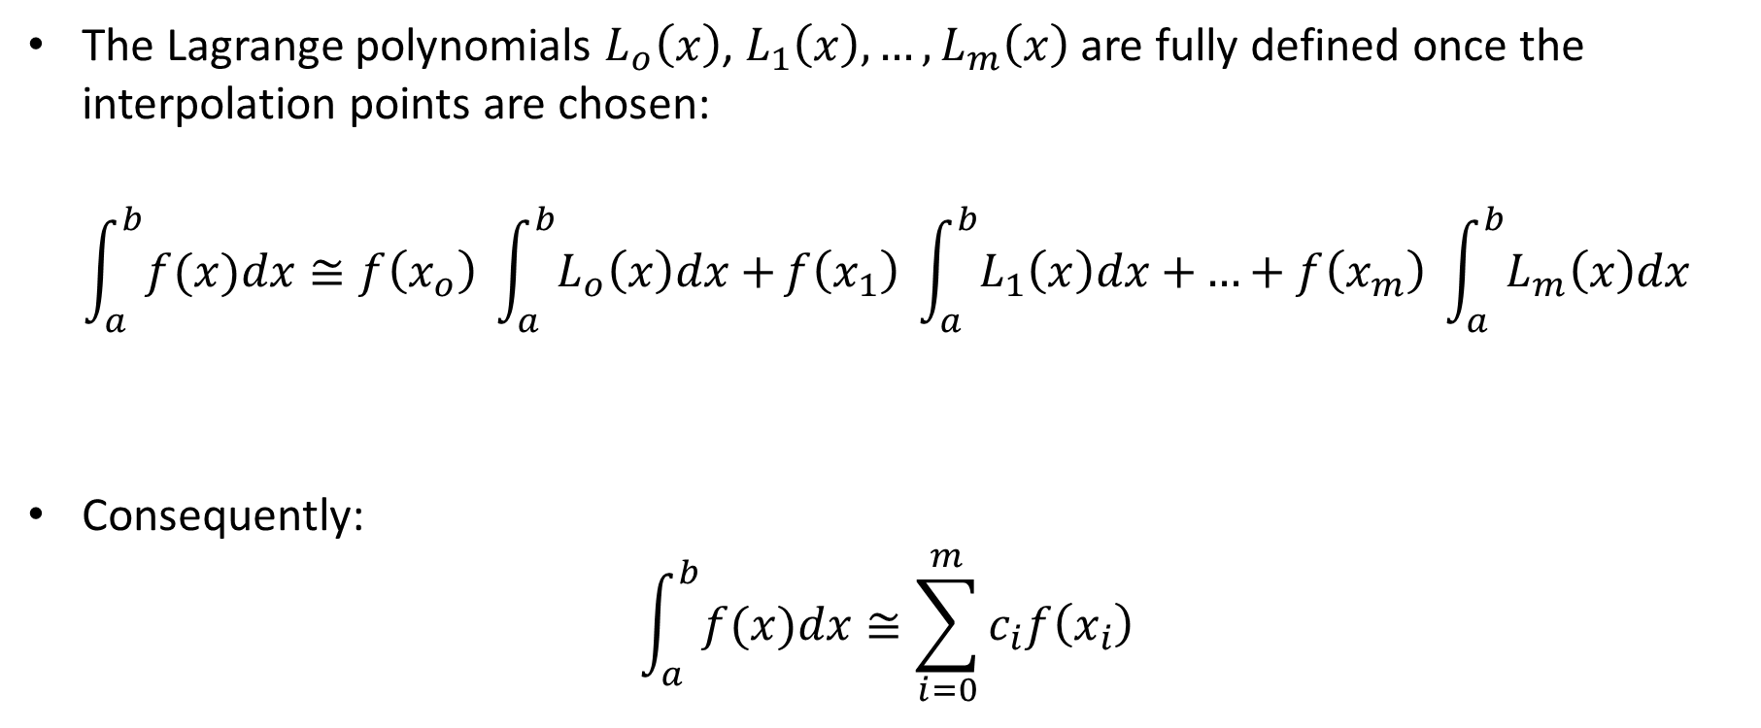



Lagrange interpolation
The Lagrange polynomials $L_{o}\left(x\right)$, $L_{1}\left(x\right),…,L_{m}\left(x\right)$ are fully defined once the interpolation points are chosen:
$$\int_{a}^{b}{f(x)dx}≅f\left(x_{o}\right) \int_{a}^{b}{L_{o}\left(x\right)dx+}f\left(x_{1}\right) \int_{a}^{b}{L_{1}\left(x\right)dx+}…+f\left(x_{m}\right) \int_{a}^{b}{L_{m}\left(x\right)dx}$$
Consequently:
$$\int_{a}^{b}{f(x)dx}≅\sum_{i=0}^{m}{c_{i}f\left(x_{i}\right)}$$
$$c_{0}$$
$$c_{1}$$
$$c_{m}$$
Notes:
Once we have chosen our interpolating points, the Lagrange polynomials $L_{o}\left(x\right)$, $L_{1}\left(x\right),…,L_{m}\left(x\right)$ are fully defined and more importantly do not depend at all of the function f(x).
If this statement is surprising for you, I recommend you to review the lecture on Lagrange interpolation.
We can therefore compute independently of f(x) their integrals. Let us call them c0, c1, … cm
Our quadrature formula becomes
$$\int_{a}^{b}{f(x)dx}≅\sum_{i=0}^{m}{c_{i}f\left(x_{i}\right)}$$
with the coefficient ci independent of f.
In coming lectures we will for some examples compute these coefficents.

Slide 7




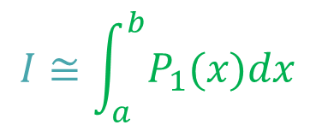


Errors of Quadrature Formulas
$$y$$
$$y=f(x)$$
$$y=P_{1}(x)$$
Error
$$I=\int_{a}^{b}{f(x)dx}$$
$$I≅\int_{a}^{b}{P_{1}(x)dx}$$
$$x$$
$$a=x_{o}$$
$$b=x_{1}$$
Notes:
The graphical interpretation of a defined integral allows us to get an intuitive understanding of the error of a quadrature formula
Consider for example the integral of the function f(x) between a and b as displayed on the slide
Let use choose two interpolation points which are the start and end point of our integration interval
The linear interpolating polynomial P1(x) is simply the line connecting the points (a, f(a)) and (b, f(b))
The quadrature formula based on this interpolating polynomial will estimate the integral of f(x) as being the surface below the line.
The error we introduce is the portion above the line. In the present case it is quite large.

Slide 8
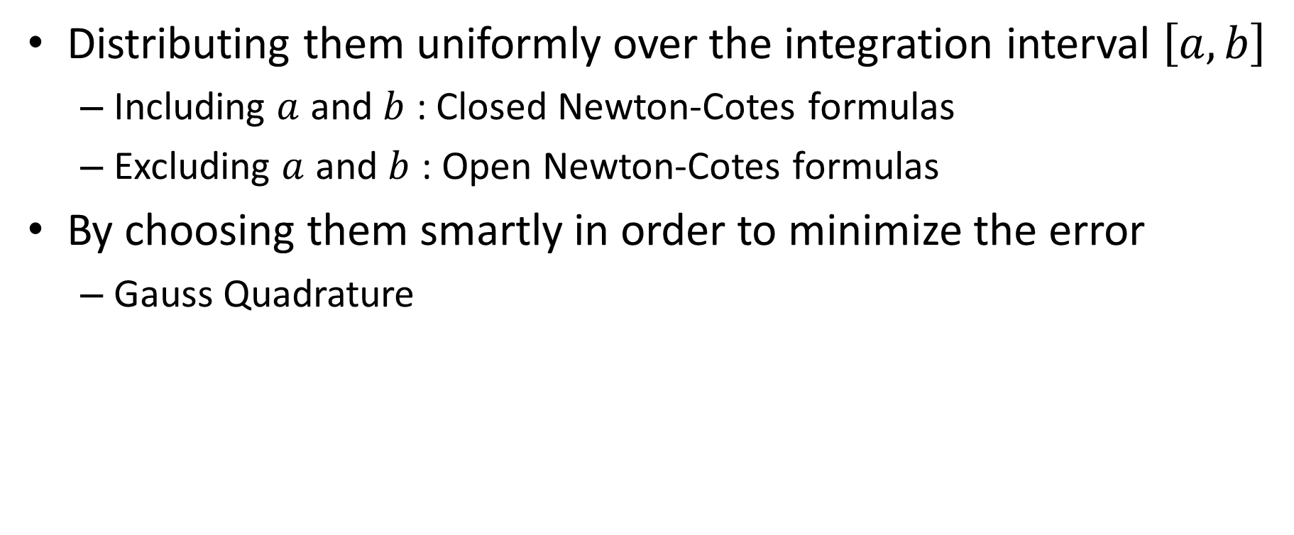
How to Choose Interpolating Points
Distributing them uniformly over the integration interval $\left[a,b\right]$
Including $a$ and $b$ : Closed Newton-Cotes formulas
Excluding $a$ and $b$ : Open Newton-Cotes formulas
By choosing them smartly in order to minimize the error
Gauss Quadrature
Notes:
How do we chose the interpolating points?
In this lesson we will discuss to possibilities
First by distributing them uniformly over the integration interval $\left[a,b\right]$
If we include the points a and b the resulting quadrature formulas are called closed Newton-Cotes formulas
If we do not include a and b then we get so called open Newton-Cotes formulas
Second we will see how the error of quadrature formulas can be minimized by choosing the location of the interpolating points smartly
The example we ill see is the Gauss integration

Slide 9

Composite Methods
Defined integrals can be calculated by the sum of defined integrals of sub-intervals:
$$I=\int_{a}^{b}{f(x)dx}=\int_{a}^{d_{1}}{f\left(x\right)dx+\int_{d_{1}}^{d_{2}}{f\left(x\right)dx+…+\int_{d_{n}}^{b}{f\left(x\right)dx}}}$$
Notes:
As you know from calculus, defined integrals can be calculated by the sum of defined integrals over sub-intervals

Slide 10


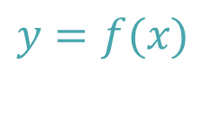



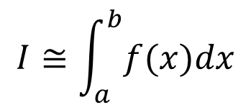




Composite Methods
$$y$$
$$y=f(x)$$
$$I≅\int_{a}^{b}{f(x)dx}$$
$$I≅I_{1}+I_{2}+I_{3}+I_{4}$$
$$I_{1}$$
$$I_{2}$$
$$I_{3}$$
$$I_{4}$$
$$x$$
$$a$$
$$d_{1}$$
$$d_{2}$$
$$d_{3}$$
$$b$$
Notes:
The fact that one can split the calculations over sub-intervals is used for the development of composite methods
The integration interval [a,b] is split into subintervals. For example into four sub-intervals as on the graph displayed on the slide
In each sub-interval a quadrature formula is used and the total integral is obtained b summing the results over the sub-intervals.

Slide 11
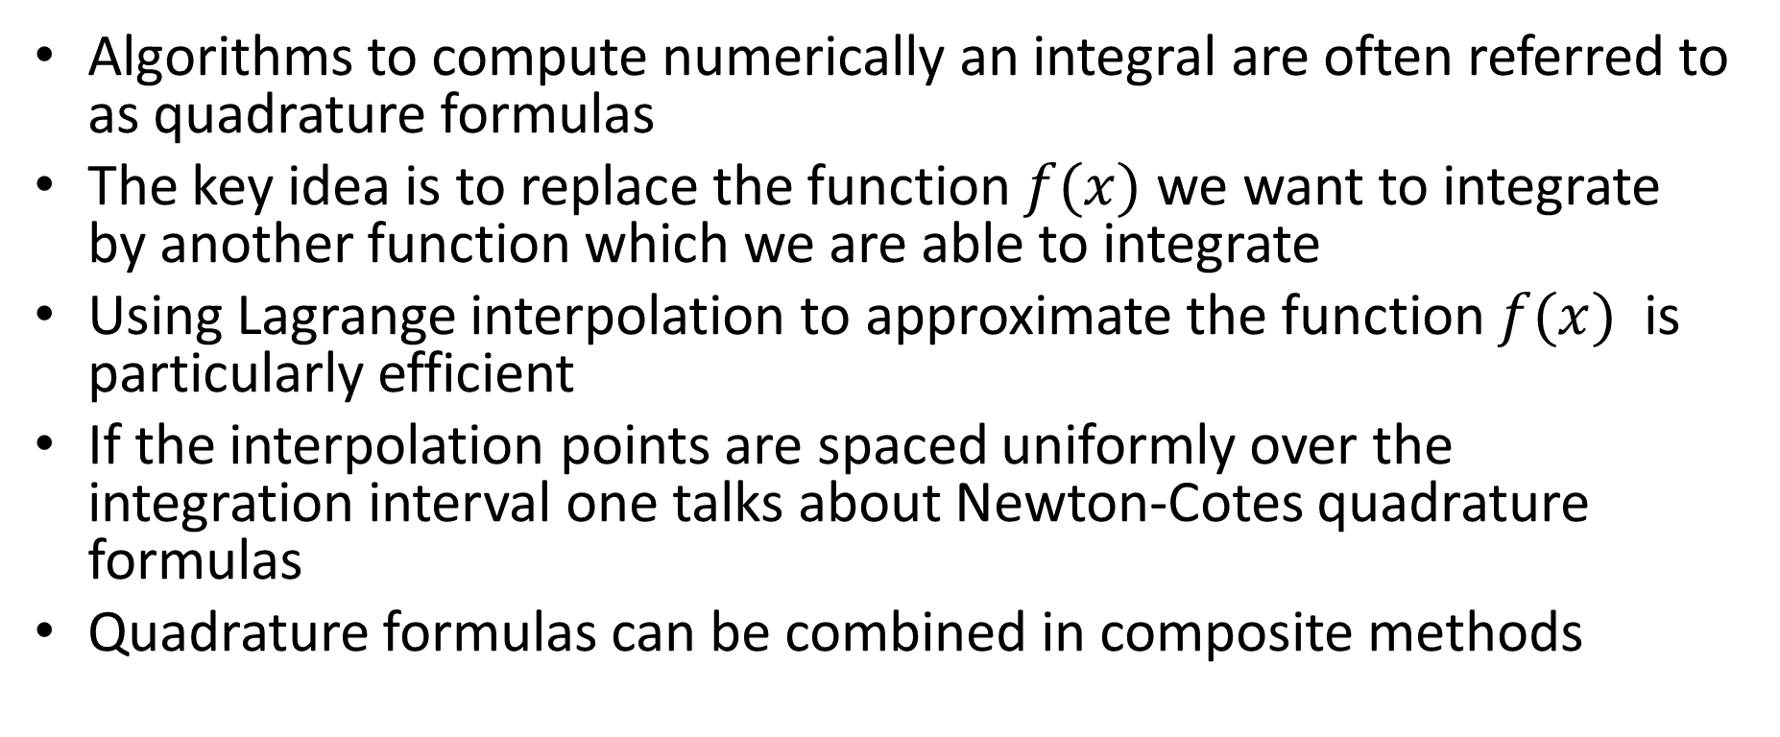
Summary
Algorithms to compute numerically an integral are often referred to as quadrature formulas
The key idea is to replace the function $f(x)$ we want to integrate by another function which we are able to integrate
Using Lagrange interpolation to approximate the function $f(x)$ is particularly efficient
If the interpolation points are spaced uniformly over the integration interval one talks about Newton-Cotes quadrature formulas
Quadrature formulas can be combined in composite methods
Notes:
Let us summarize the key concepts
- Algorithms to compute numerically an integral are often referred to as quadrature formulas
- The key idea is to replace the function $f(x)$ we want to integrate by another function which we are able to integrate
- Using Lagrange interpolation to approximate the function $f(x)$ is particularly efficient
- If the interpolation points are spaced uniformly over the integration interval one talks about Newton-Cotes quadrature formulas
- Quadrature formulas can be combined in composite methods

